Slide 1

Mars Rover Autonomous Navigation
28
Osama
Mars Rover : Autonomous Navigation
Team 28: Tommy Lam, Kelly Lee, Brian He, Daniel Crawley, Linden Vo

Slide 2
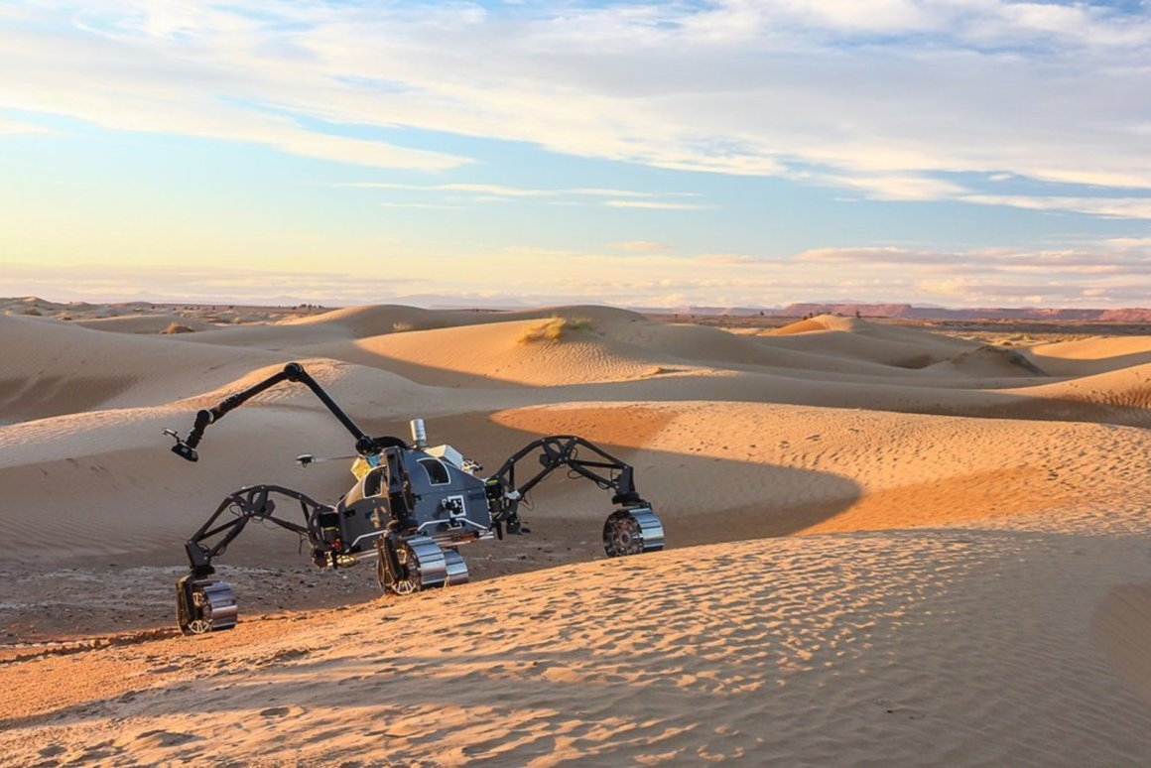
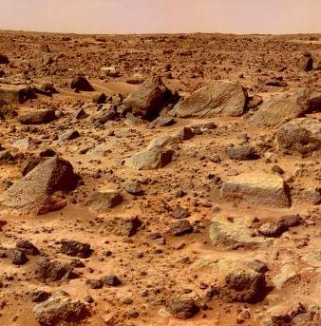
28
Mars Rover Autonomous Navigation
Osama
Problem Statement
Design, build, integrate, and test a rover capable of autonomous movement with the use of GPS that can travel the terrain of Mars or similar and withstand weather and atmosphere conditions using visual navigation and inertial navigation.

Slide 3
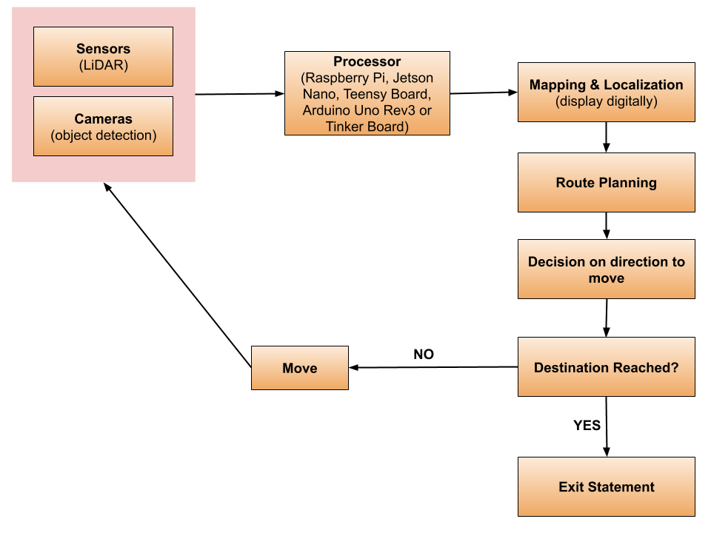
28
Mars Rover Autonomous Navigation
Osama
Visualization

Slide 4
28
Mars Rover Autonomous Navigation
Osama
Deliverables
Functional vehicle with chassis
Autonomous control algorithms
Fully integrated sensors into vehicle subsystems
Overall: a fully integrated vehicle as a proof of concept that can also be potentially officially submitted to the University Mars Rover challenge

Slide 5

Mars Rover Autonomous Navigation
Requirements: Functions
Detect AR tags and visually recognise “gates”
Autonomously navigate with such data as well as GPS
Kill switch
LEDs to indicate state
Operable non-autonomously, beyond line of sight
Autonomously navigate around obstacles

Slide 6
Mars Rover Autonomous Navigation
Requirements: Objectives
Given GPS coordinate of post, autonomously navigate to within 3m of it
GPS coordinate of up to 5m from post, autonomously navigate to within that distance and follow an AR tag to the post
GPS coordinate, pass through gate autonomously
GPS coordinate 10m from gate, pass through gate autonomously
GPS coordinate, navigate to next post while avoiding obstacle(s)
GPS coordinate 10m from gate, avoid obstacles and pass through gate
bring Mark Watney back from Mars

Slide 7
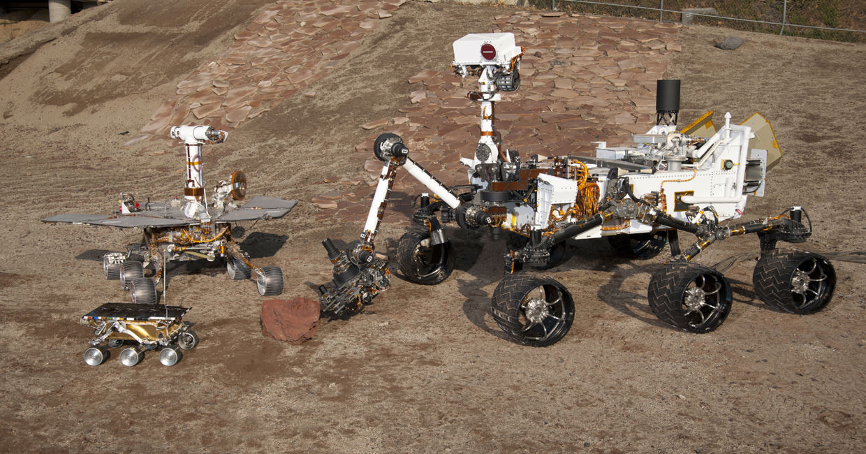
28
Mars Rover Autonomous Navigation
Osama
Requirements: Constraints
Fits 1.2m x 1.2m box
50kg while deployed
Nothing airbourne or reliant on air
For competition, withstand heat of up to 100°F, winds whipping up dust, and light rain
Part of $18k budget (1 challenge of 4)

Slide 8
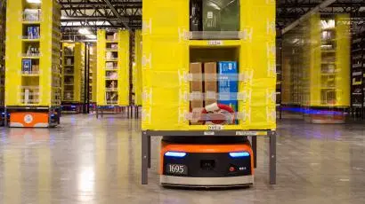
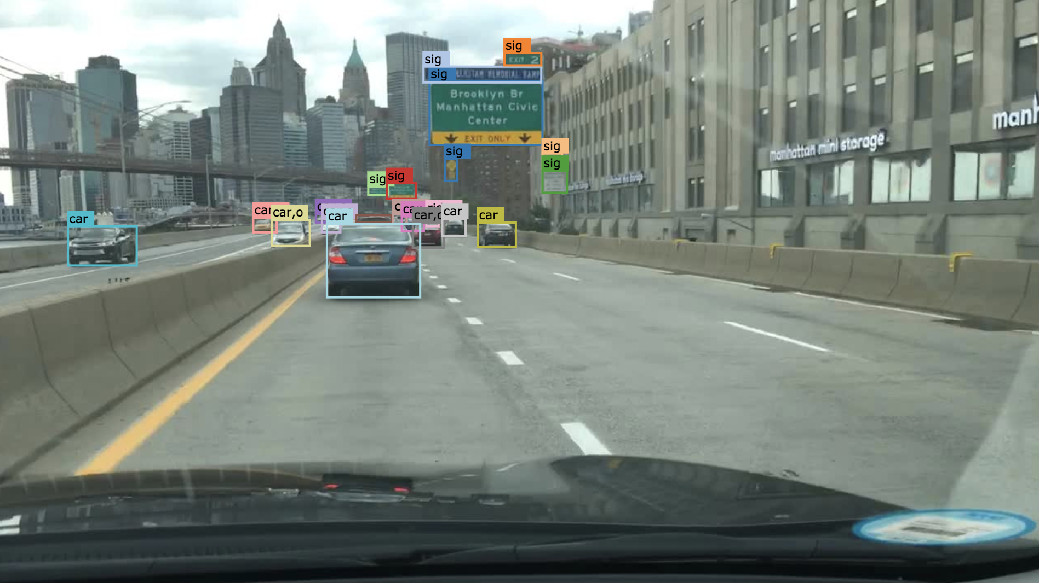
28
Mars Rover Autonomous Navigation
Osama
Competing Technologies / Patents / Other Products
- Amazon Robotics
- Berkeley DeepDrive
- Other Mars Rover Teams

